Slide 1

Sain Saburaj
Guided by,
Asst. Prof. Vaisakh M
MCA 23

Slide 2


01
INTRODUCTION
Overview of the Pixtream social media platform and its objectives.
02
SYSTEM SPECIFICATION
Details about the technologies, tools, and environment used for development.
03
MODULES
Breakdown of the key components and functionalities in Pixtream.
04
MODULE DESCRIPTION
Explanation of the features and operations within each module.
05
UML DIAGRAMS
Visual representation of the system design through use case, activity, sequence, and database diagrams.
06
TABLE DESIGN
Structure and relationships between database tables used in Pixtream.

Slide 3
INTRODUCTION
Pixtream Overview: Pixtream is a simplified social media platform that allows users to post photos, videos, follow others, interact with posts, and send messages.
Objective: The project aims to create a platform, where users can share and engage with multimedia content in real time.
Technologies Used:
Backend: PHP, MySQL
Frontend: HTML, CSS (Bootstrap), JavaScript
Web Server: XAMPP

Slide 4
SYSTEM SPECIFICATION
Operating System: Cross-platform (Windows, macOS, Linux)
Development Tools:
XAMPP (Apache, MySQL, PHP)
Text Editor/IDE (e.g., VSCode)
Languages Used:
Frontend: HTML, CSS (Bootstrap), JavaScript
Backend: PHP
Database: MySQL
Database Name: pixtream
Browser Compatibility: Supports all modern web browsers (Chrome, Firefox, Edge, Brave, Safari)

Slide 5
MAIN MODULE - USERS
The Users Module in Pixtream is the core part of the system, handling all user-related functionalities. It includes:
User Registration and Login:
Users can sign up with unique credentials and securely log in.
Registration includes filling in basic details like username, email, and password.
Profile Management:
Users can create and update profiles with bio, location, and profile picture.
Interests can be selected during profile completion, and users can edit their selections anytime.
Post Creation and Interaction:
Users can upload different types of content (photos, videos, etc.) and add captions.
Interact with posts by liking, commenting, and sharing them with others.

Slide 6
MAIN MODULE - USERS
Following and Followers:
Users can follow or unfollow others, creating connections within the platform.
View suggested users to follow, based on activity or mutual connections.
Messaging:
Users can send and receive direct messages with other users.
A messaging interface allows real-time conversations between users.
Saved Posts:
Users can save posts for later viewing or reference, adding them to a personal collection.
Saved posts can be unsaved at any time.

Slide 7
MAIN MODULE - USERS
Blocking Users:
Users can block others to restrict interactions.
A blocked user cannot follow, message, or interact with the blocker’s posts.

Slide 8
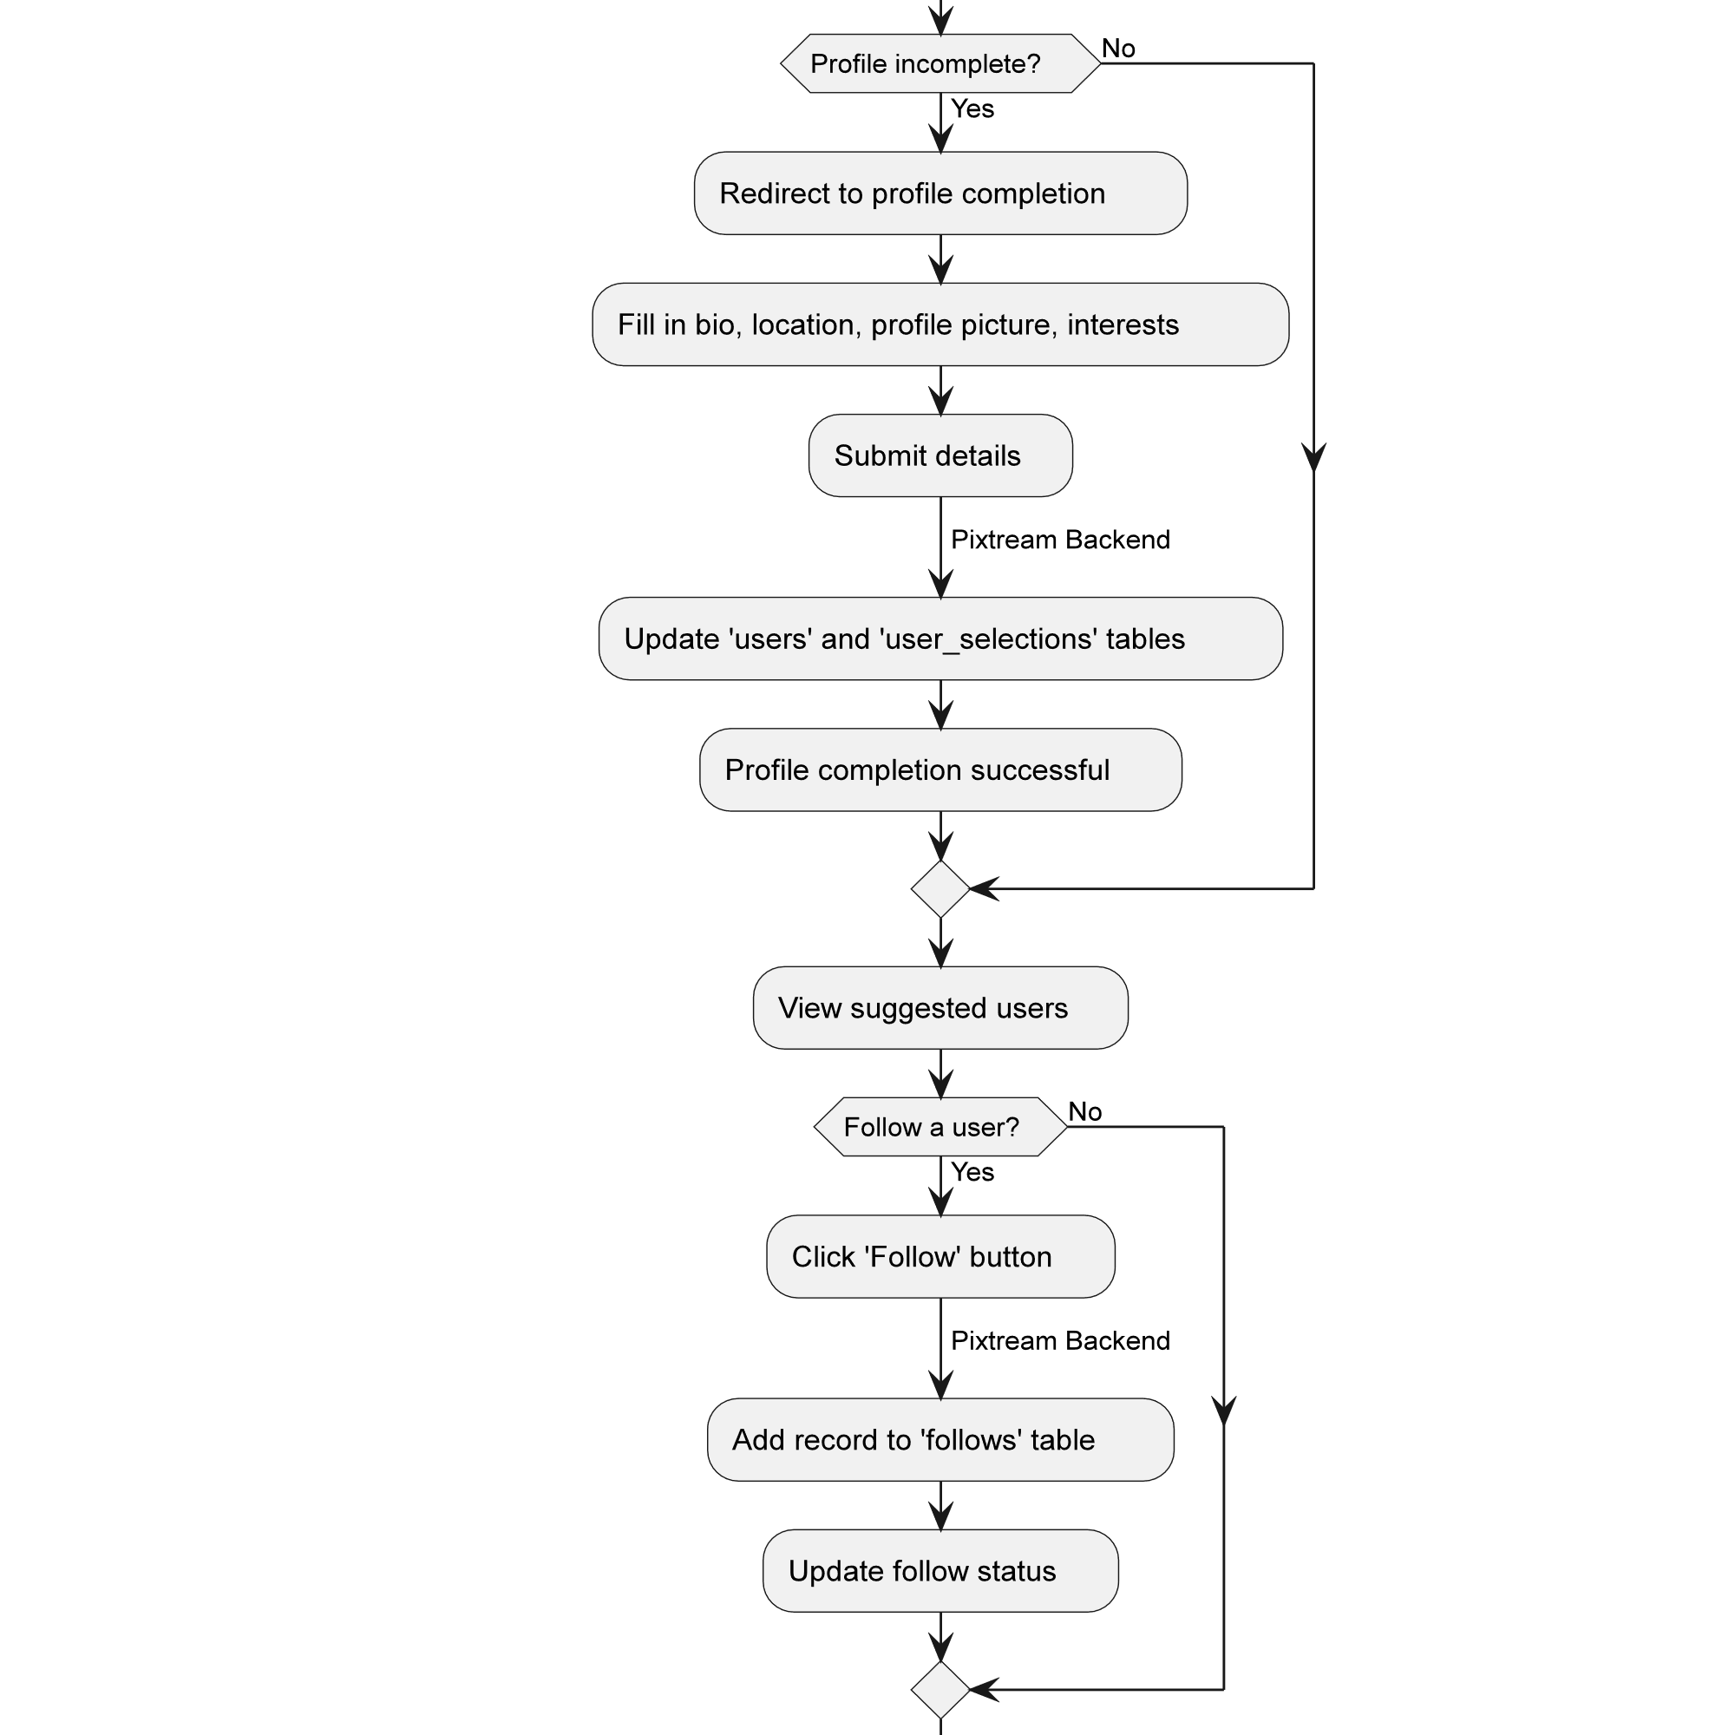
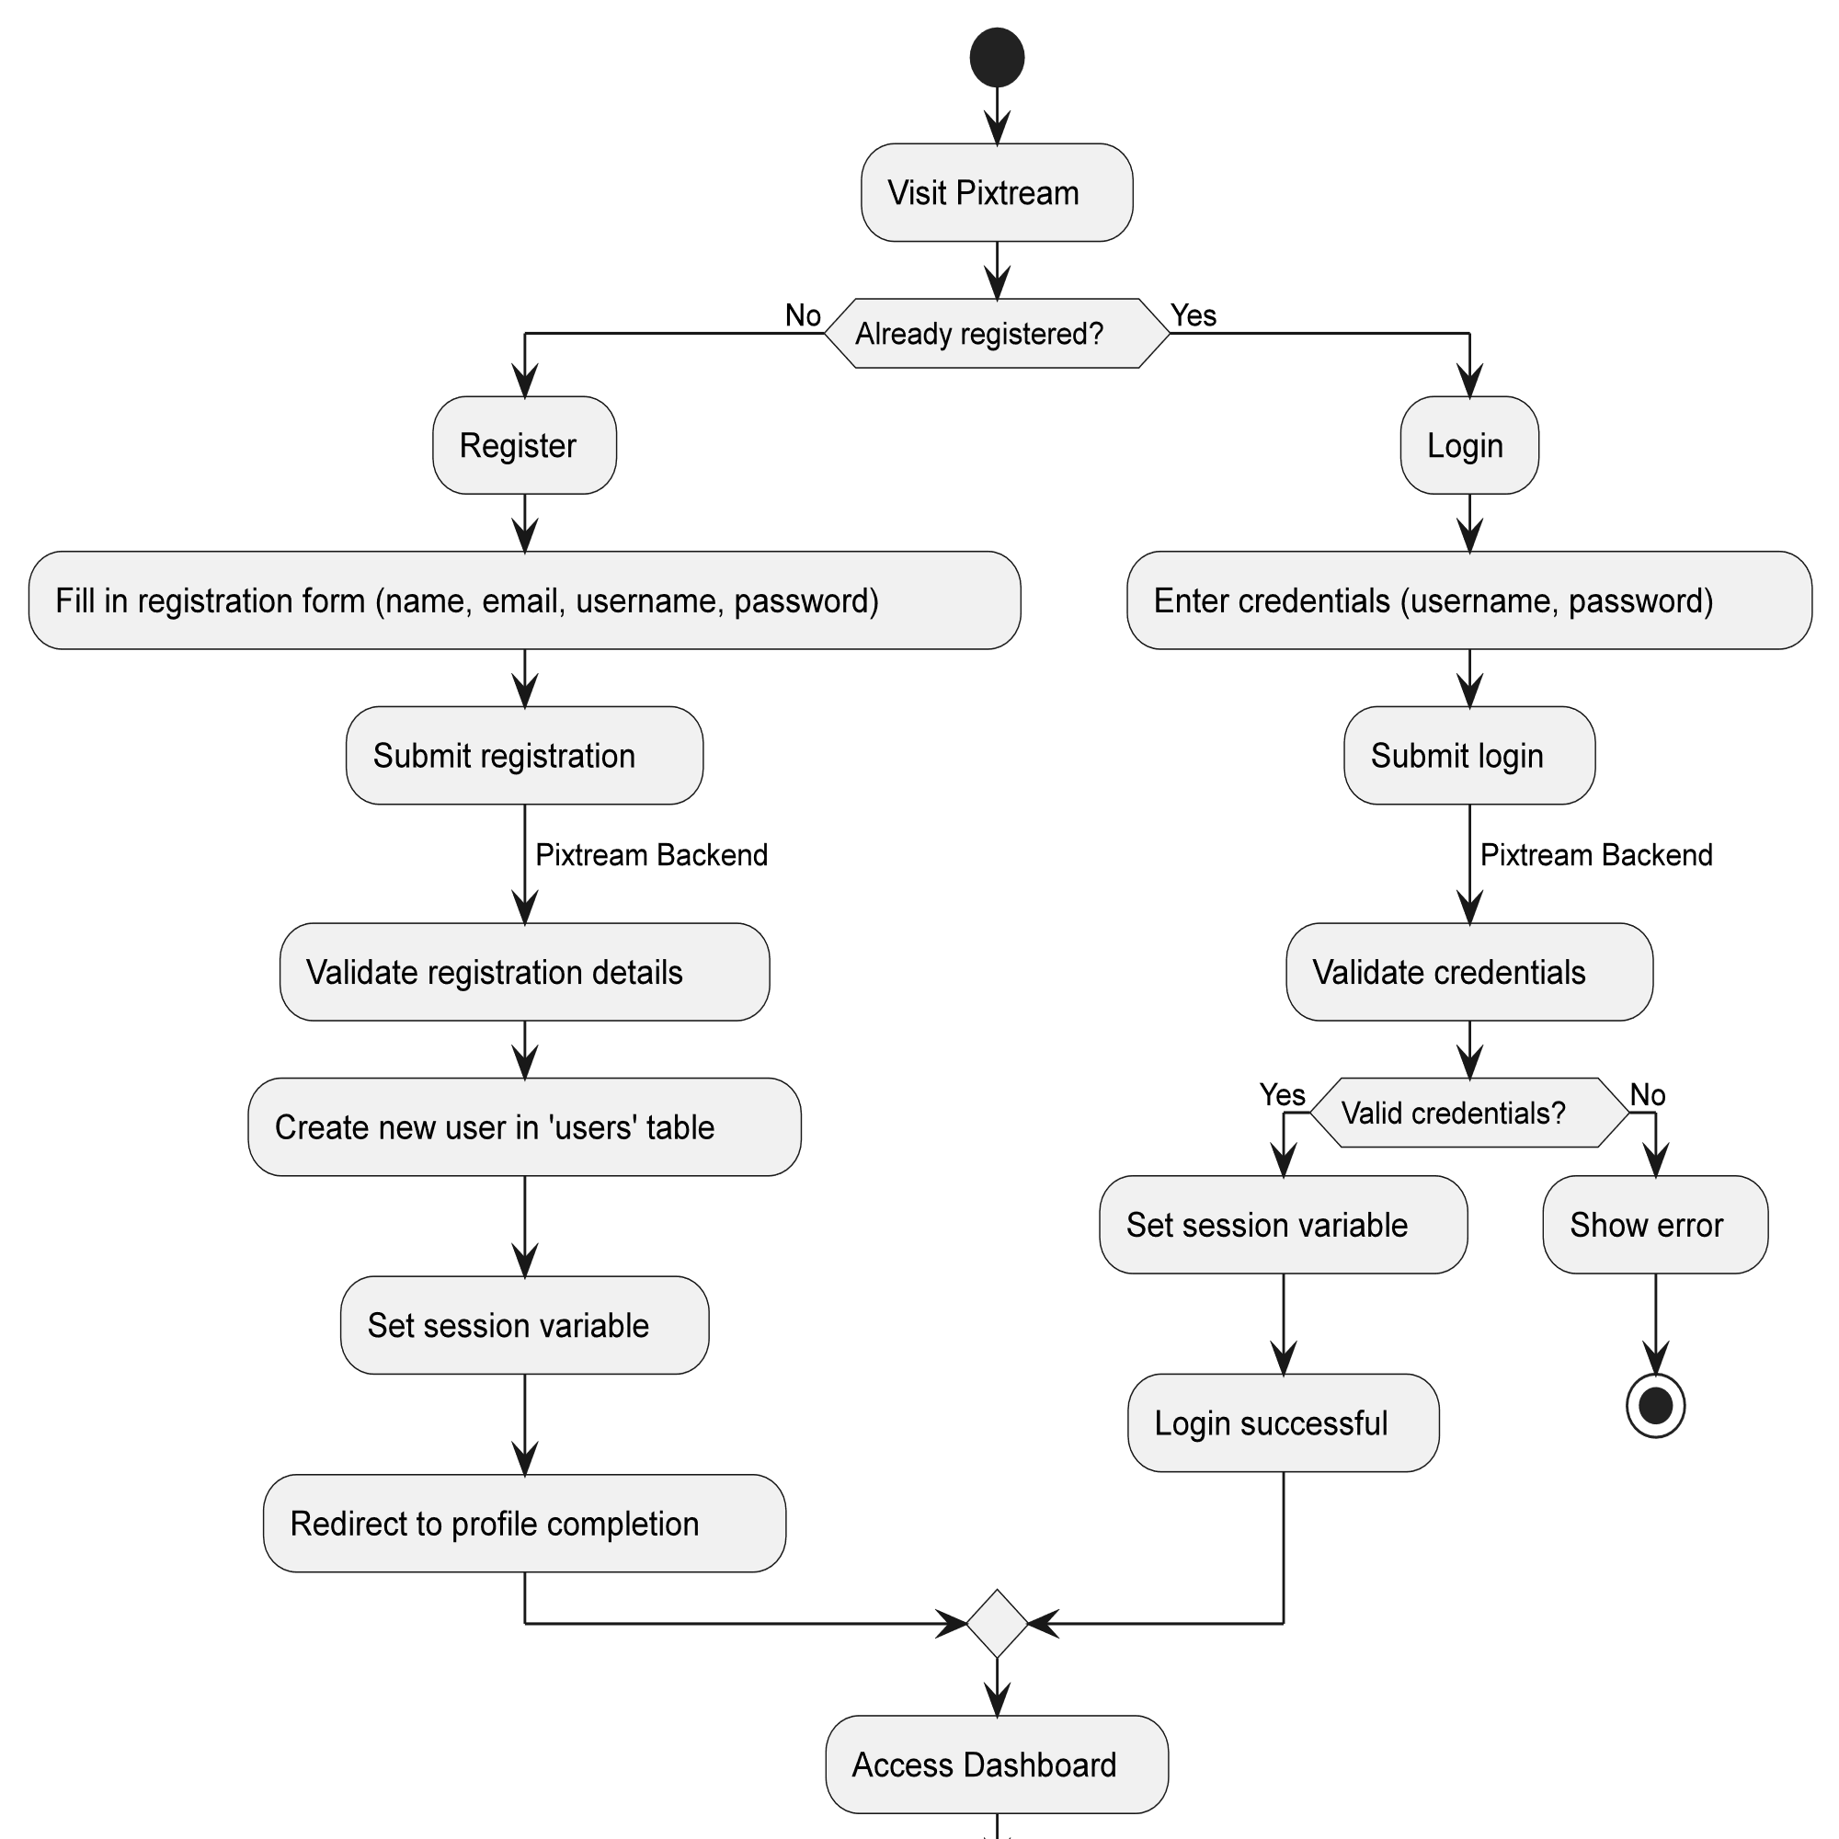
UML DIAGRAMS
Activity Diagram

Slide 9
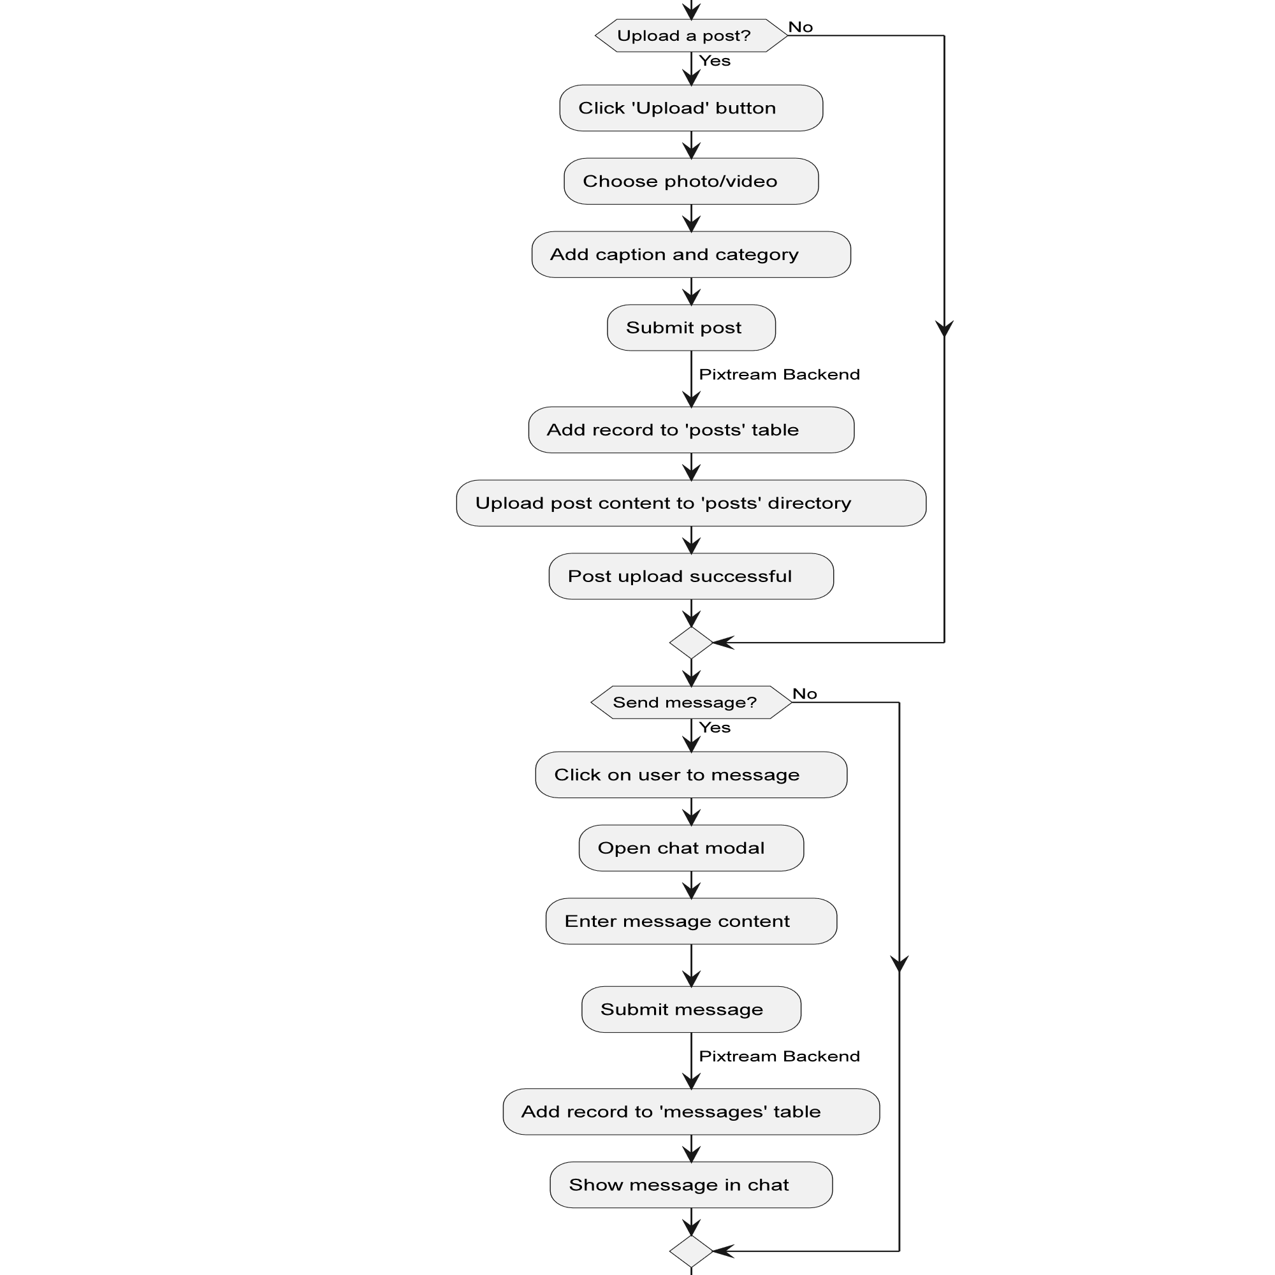
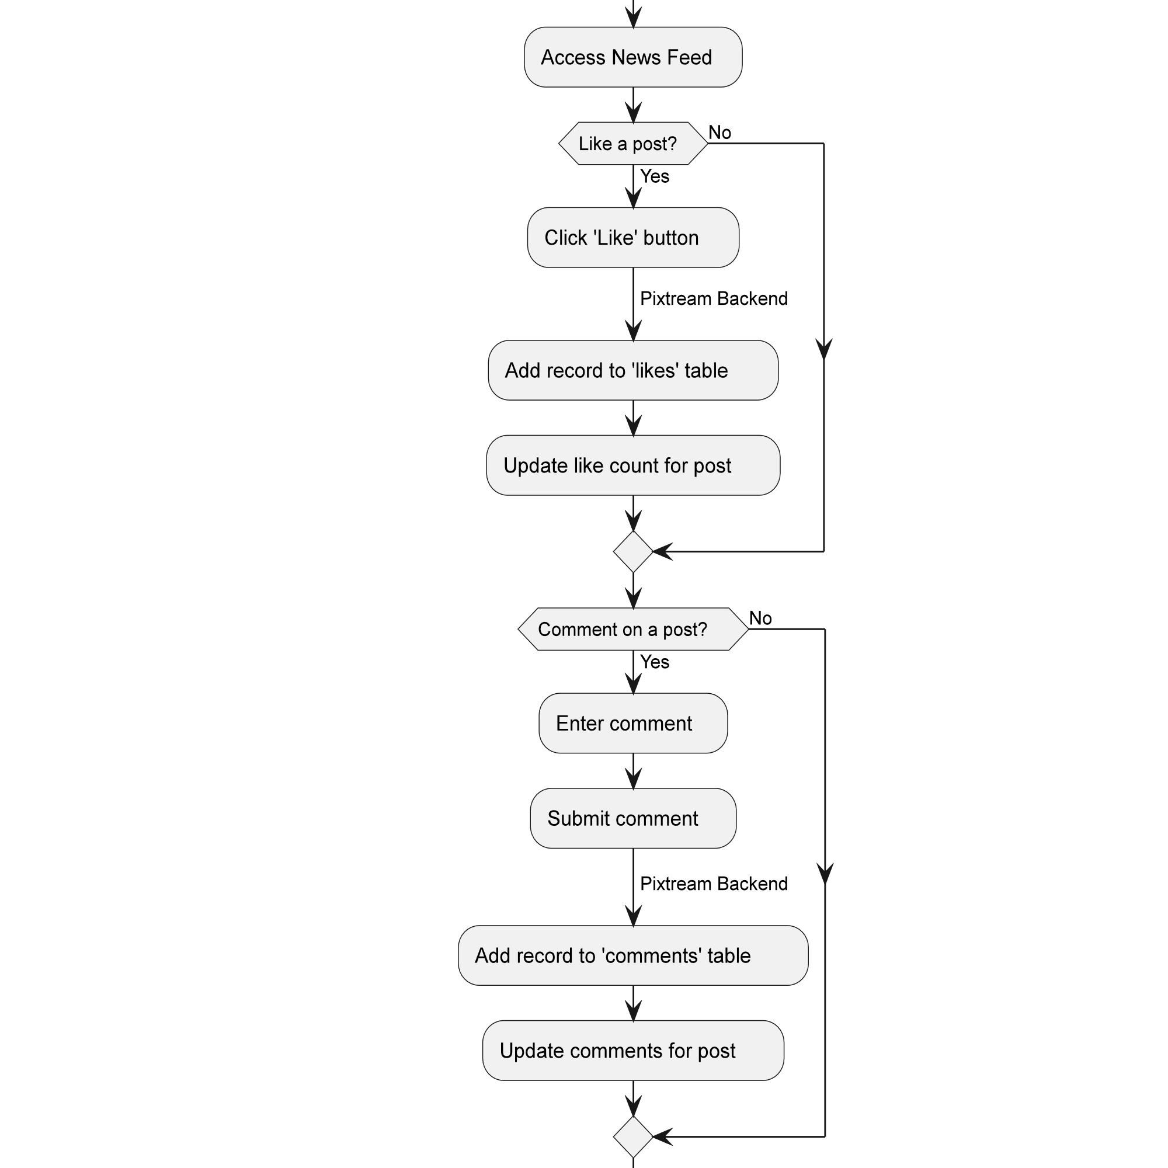
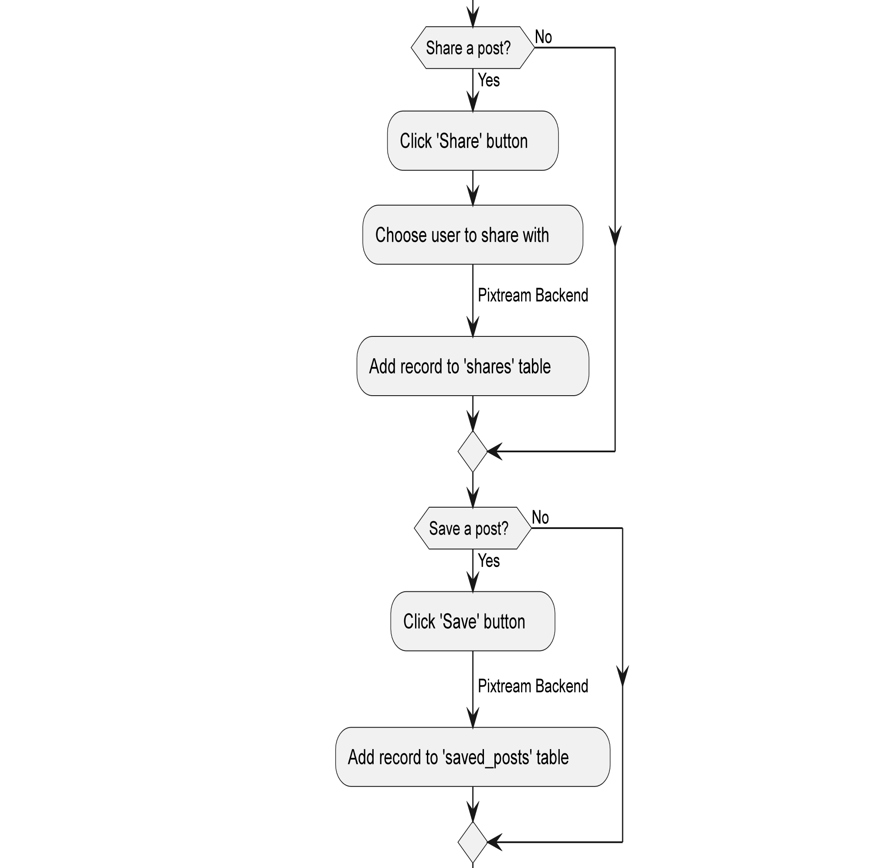

Slide 10
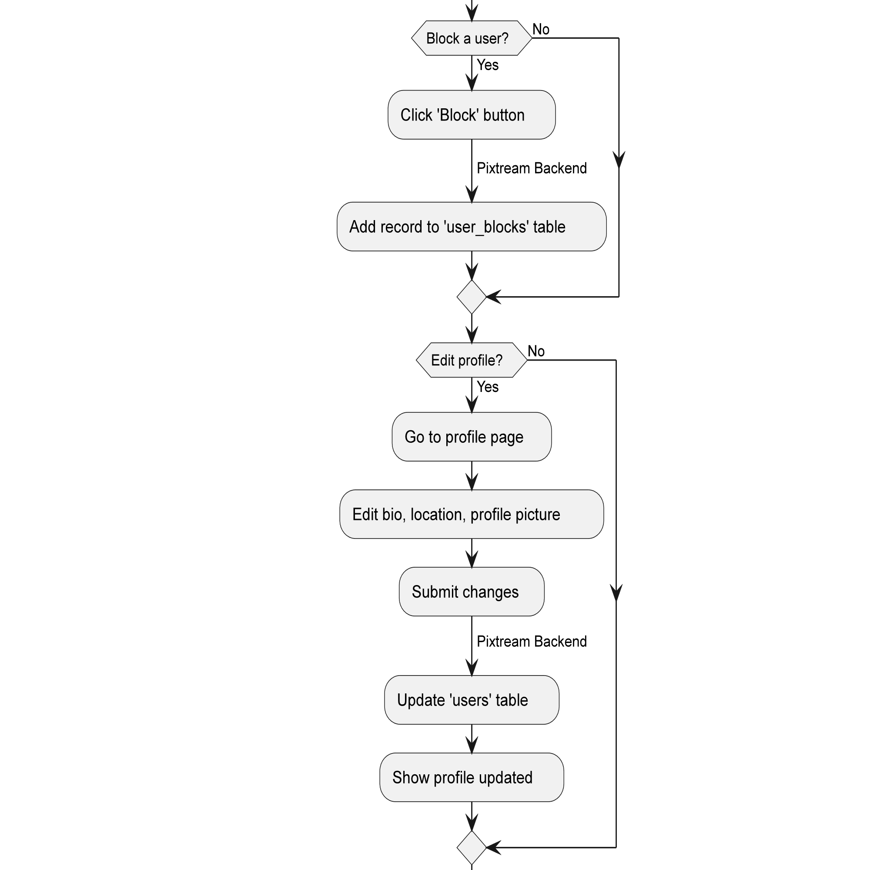
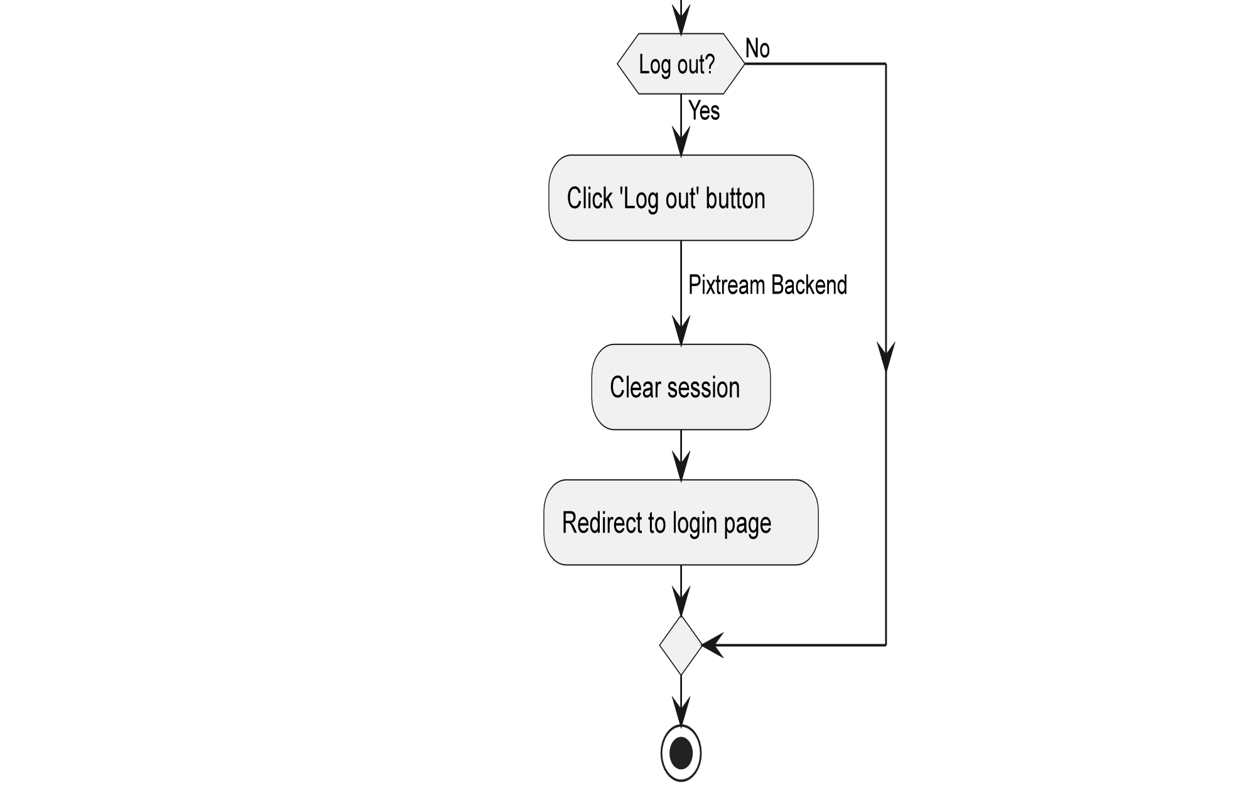

Slide 11
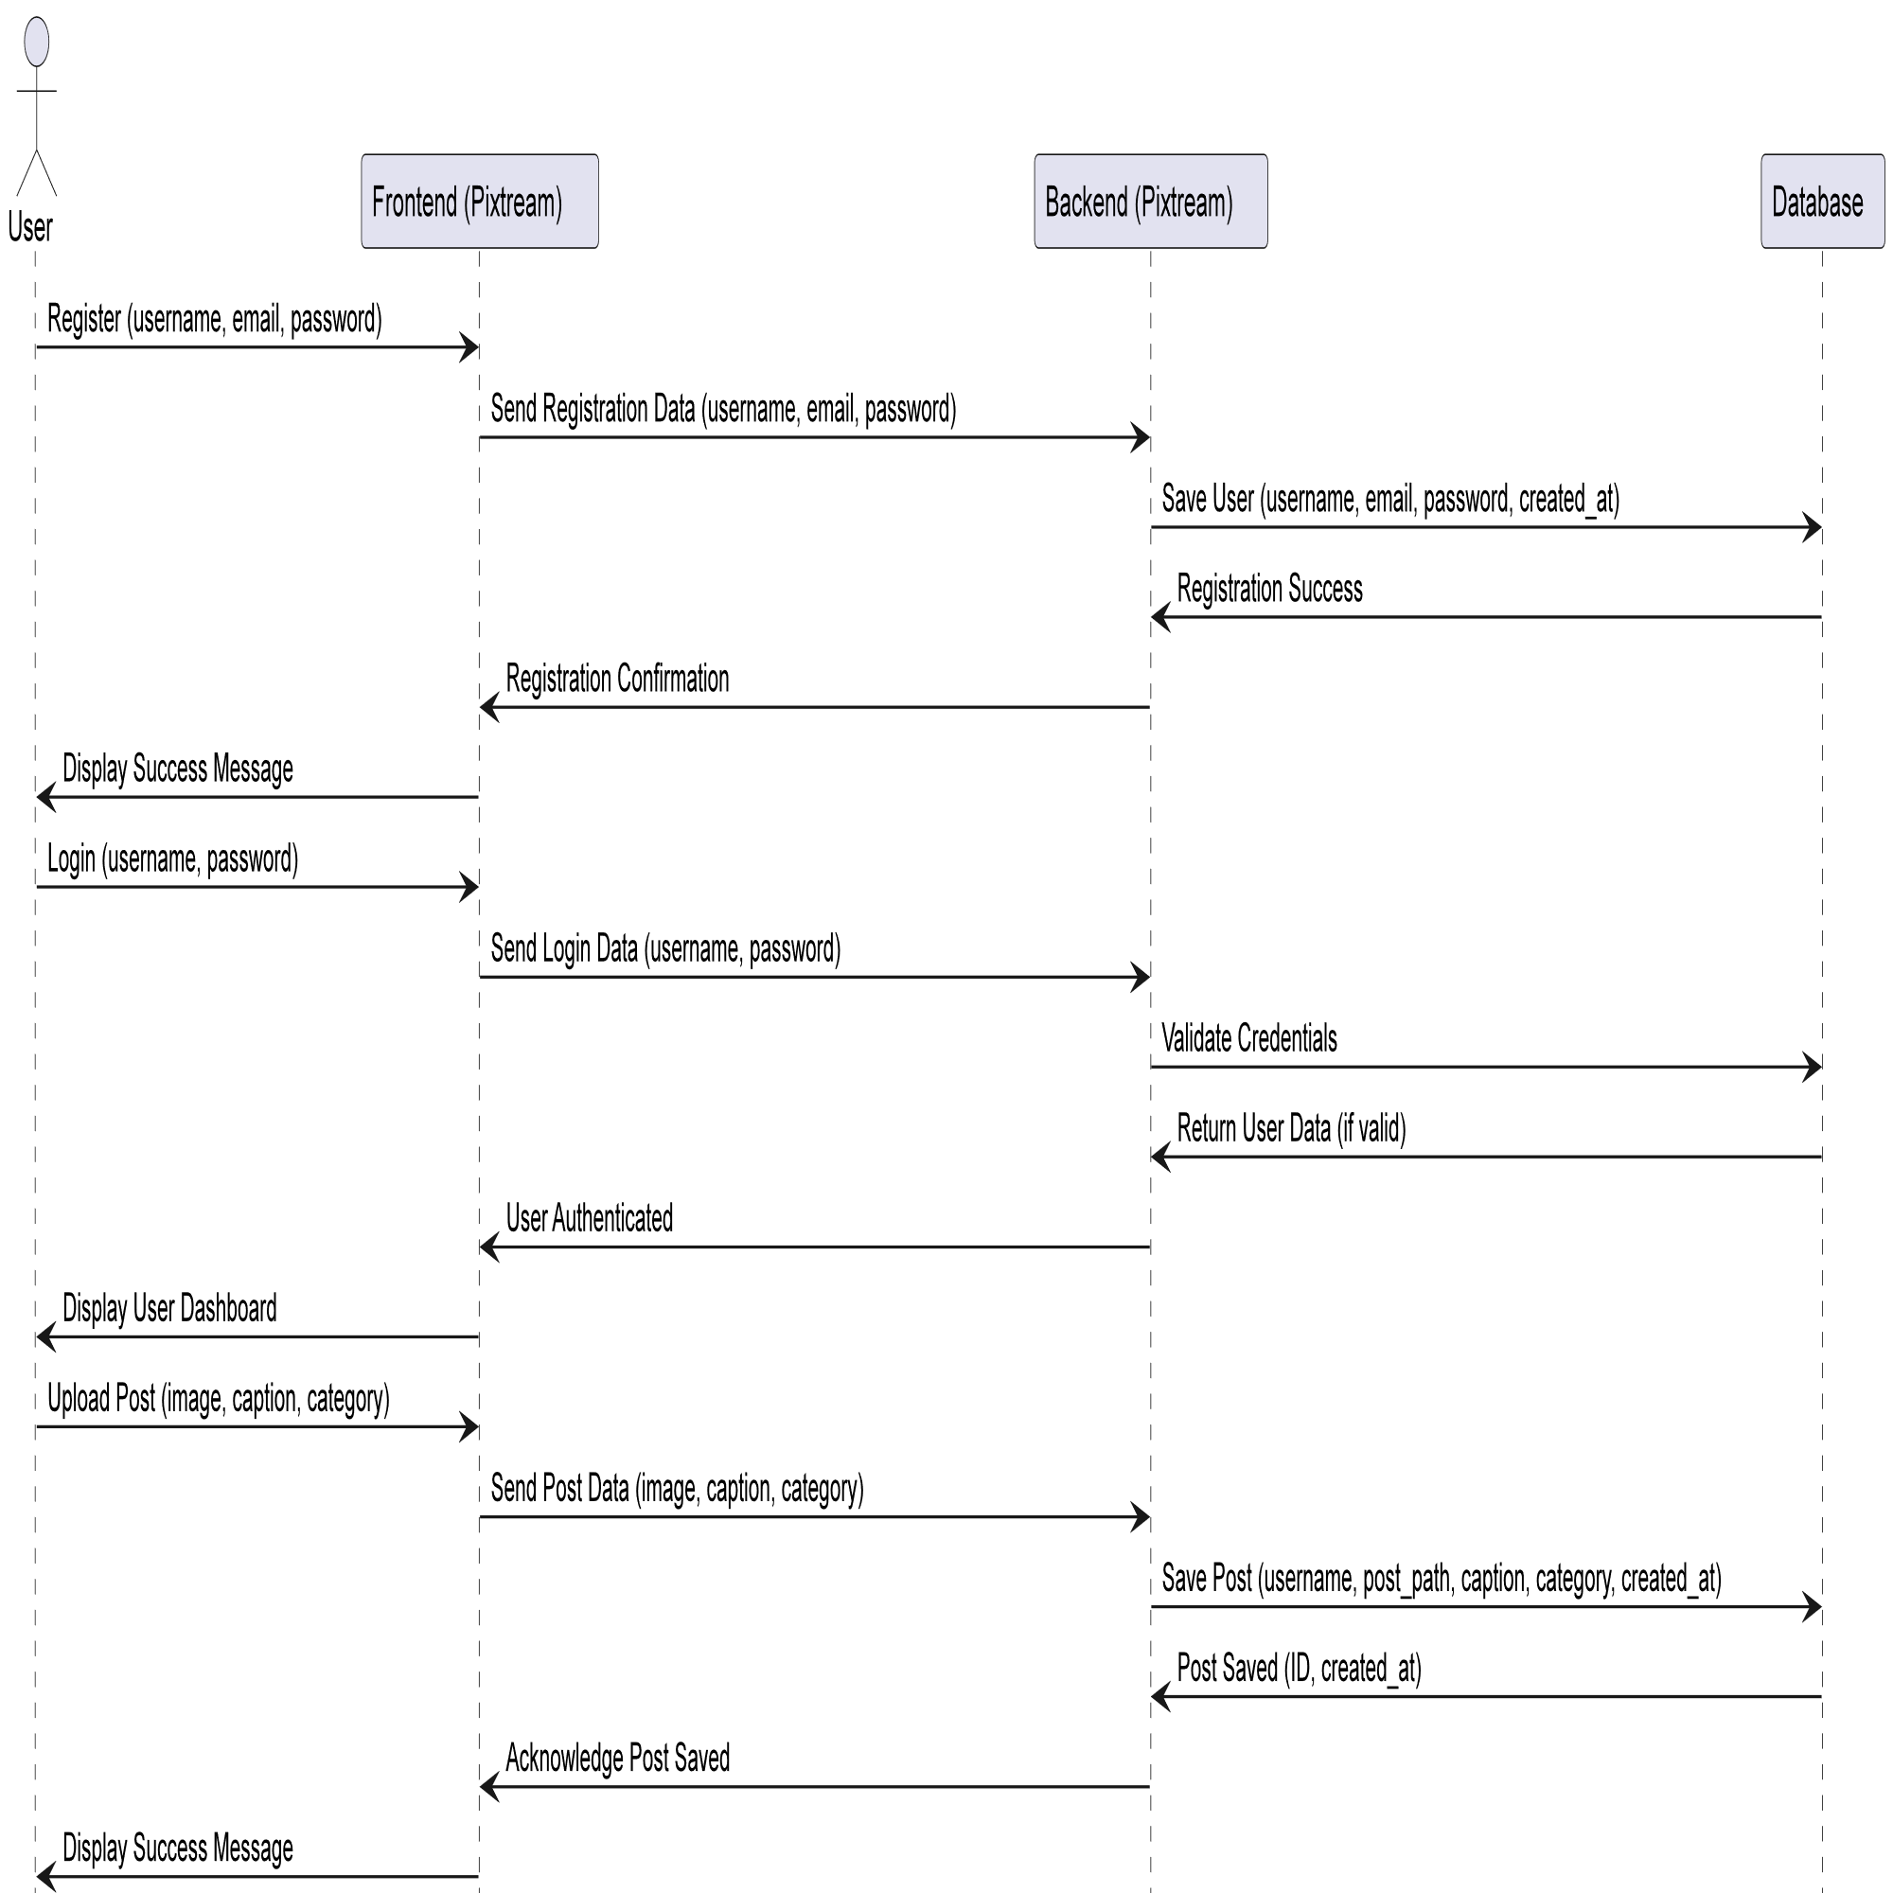
UML DIAGRAMS
Sequence Diagram

Slide 12
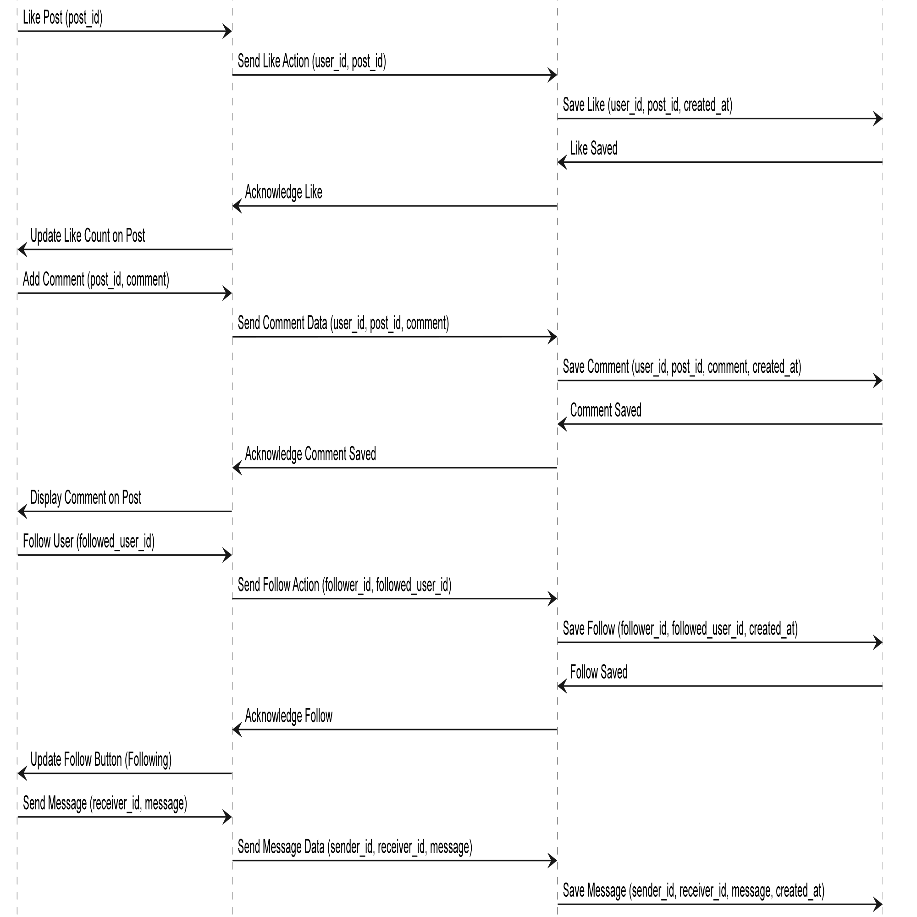

Slide 13
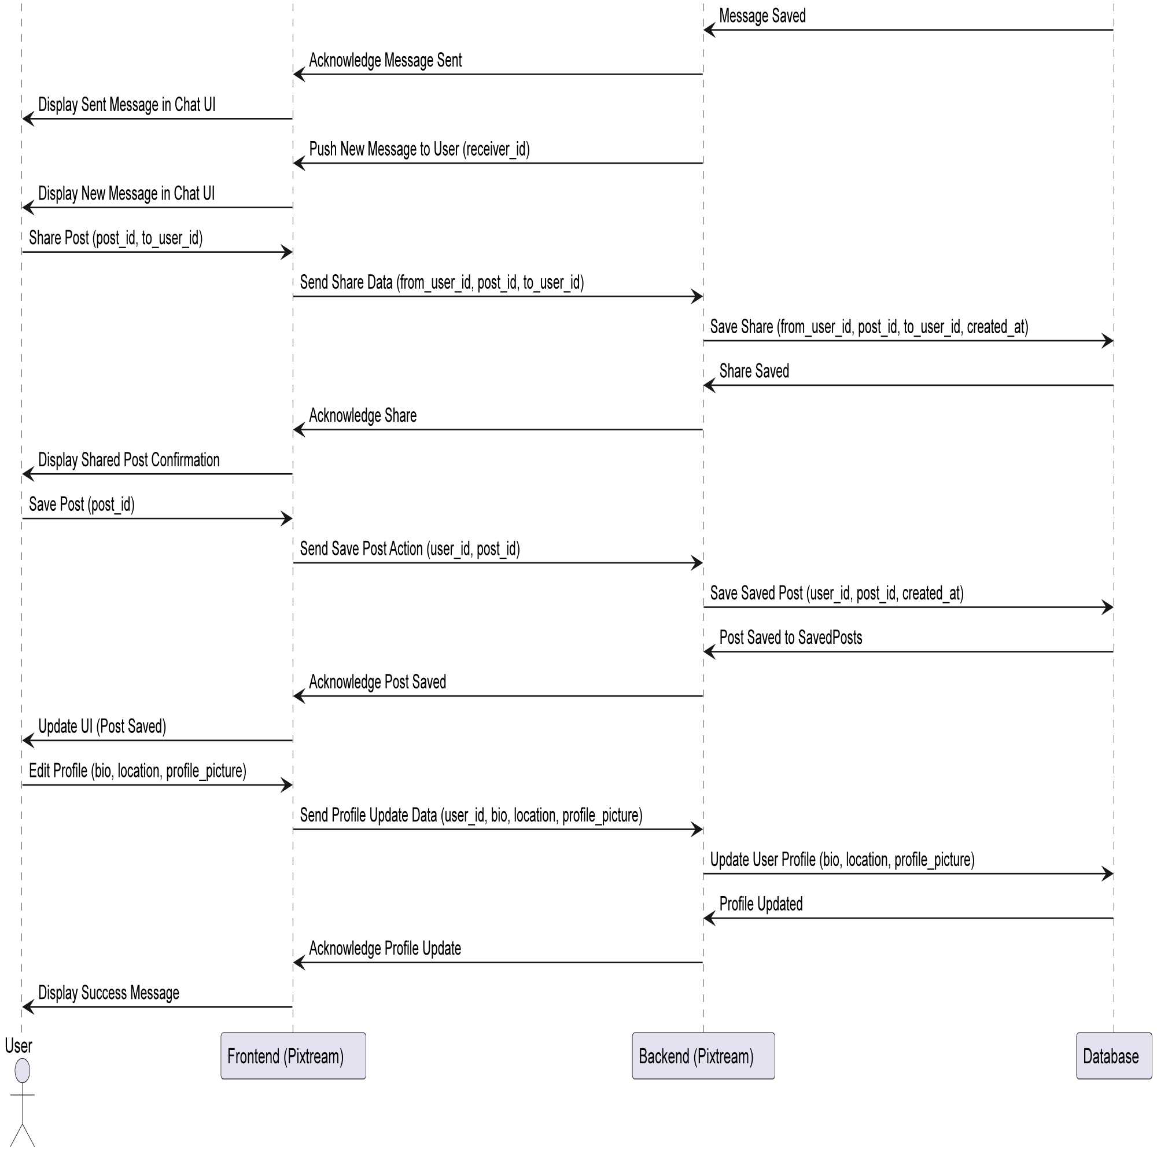

Slide 14
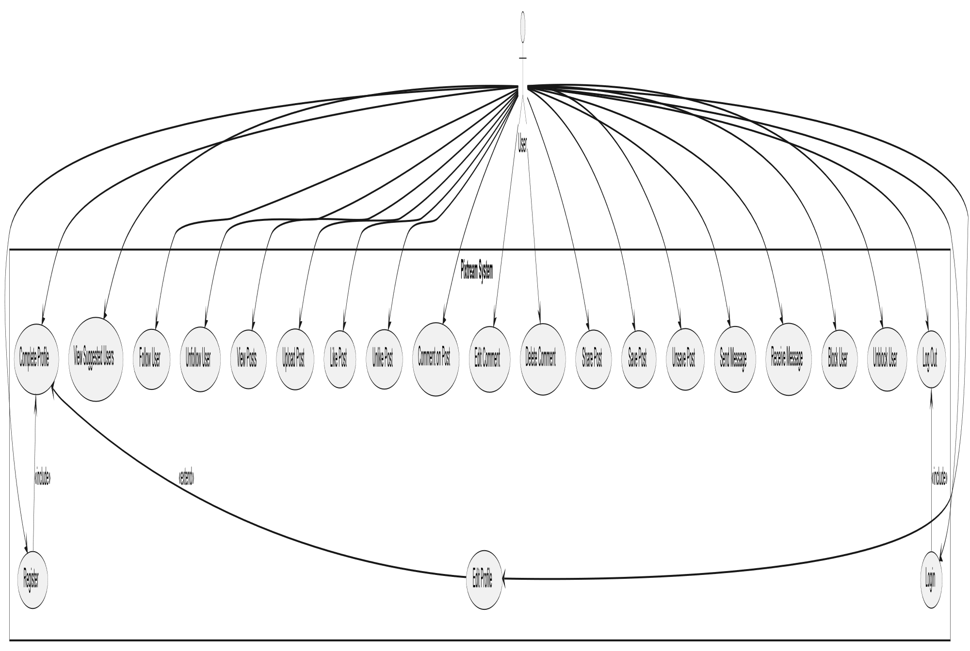
UML DIAGRAMS
Use case Diagram

Slide 15
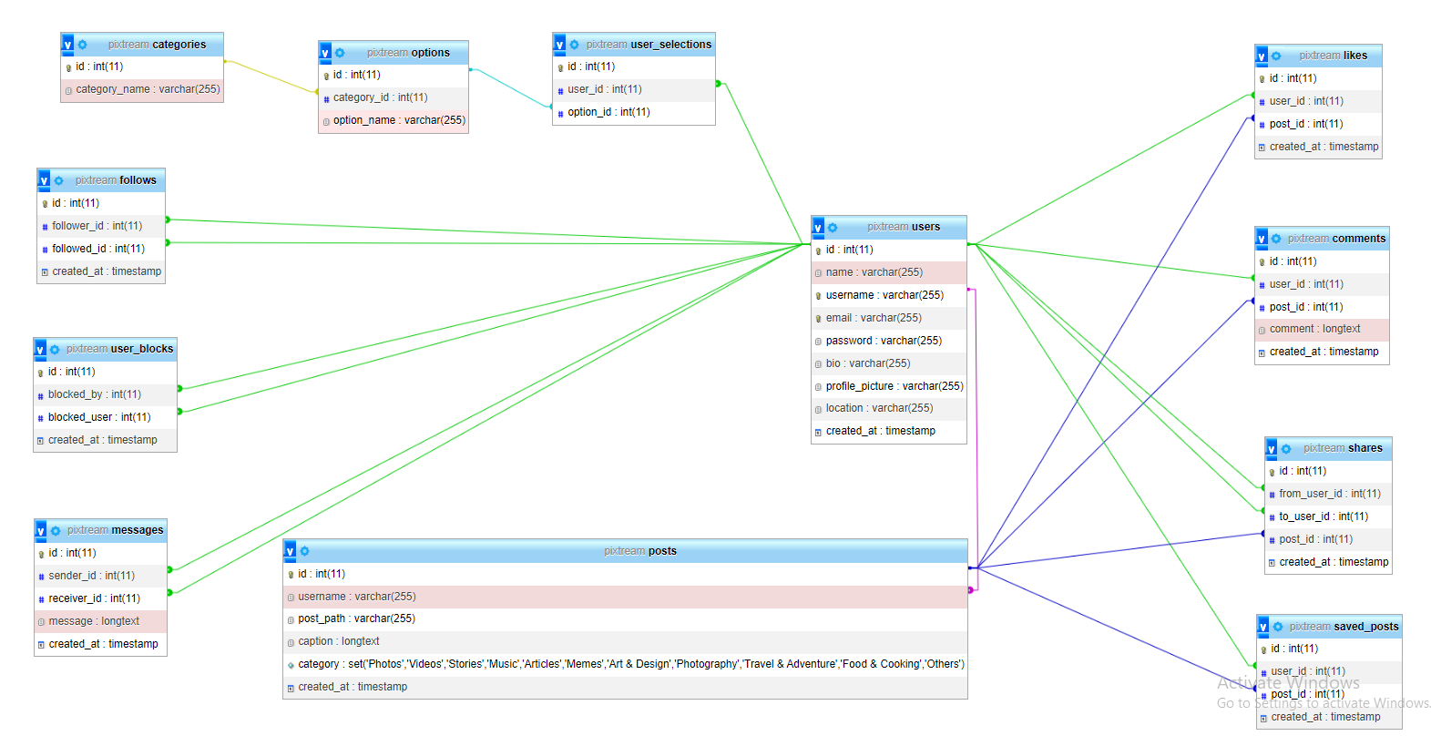
DATABASE DESIGN

Slide 16
TABLE DESIGN
Users Table
Posts Table
COLUMN NAME | DATA TYPE | CONSTRAINTS
id | INT | Primary Key, Auto Increment
name | VARCHAR | Not Null
username | VARCHAR | Unique, Not Null
email | VARCHAR | Unique, Not Null
password | VARCHAR | Not Null
bio | VARCHAR | Optional
profile_picture | VARCHAR | Optional
location | VARCHAR | Optional
created_at | TIMESTAMP | Default: Current Timestamp
COLUMN NAME | DATA TYPE | CONSTRAINTS
id | INT | Primary Key, Auto Increment
username | VARCHAR | Foreign Key (References users(id))
post_path | VARCHAR | Not Null
caption | LONGTEXT | Optional
caption | LONGTEXT | Optional
created_at | TIMESTAMP | Default: Current Timestamp

Slide 17
TABLE DESIGN
Messages Table
Follows Table
COLUMN NAME | DATA TYPE | CONSTRAINTS
id | INT | Primary Key, Auto Increment
sender_id | INT | Foreign Key (References users(id))
receiver_id | INT | Foreign Key (References users(id))
message | LONGTEXT | Not Null
created_at | TIMESTAMP | Default: Current Timestamp
COLUMN NAME | DATA TYPE | CONSTRAINTS
id | INT | Primary Key, Auto Increment
follower_id | INT | Foreign Key (References users(id))
followed_id | INT | Foreign Key (References users(id))
created_at | TIMESTAMP | Default: Current Timestamp

Slide 18
TABLE DESIGN
Likes Table
Comments Table
COLUMN NAME | DATA TYPE | CONSTRAINTS
id | INT | Primary Key, Auto Increment
user_id | INT | Foreign Key (References users(id))
post_id | INT | Foreign Key (References posts(id))
created_at | TIMESTAMP | Default: Current Timestamp
COLUMN NAME | DATA TYPE | CONSTRAINTS
id | INT | Primary Key, Auto Increment
user_id | INT | Foreign Key (References users(id))
post_id | INT | Foreign Key (References posts(id))
comment | LONGTEXT | Not Null
created_at | TIMESTAMP | Default: Current Timestamp

Slide 19
TABLE DESIGN
Shares Table
Saved Posts Table
COLUMN NAME | DATA TYPE | CONSTRAINTS
id | INT | Primary Key, Auto Increment
from_user_id | INT | Foreign Key (References users(id))
to_user_id | INT | Foreign Key (References users(id))
post_id | INT | Foreign Key (References posts(id))
created_at | TIMESTAMP | Default: Current Timestamp
COLUMN NAME | DATA TYPE | CONSTRAINTS
id | INT | Primary Key, Auto Increment
user_id | INT | Foreign Key (References users(id))
post_id | INT | Foreign Key (References posts(id))
created_at | TIMESTAMP | Default: Current Timestamp

Slide 20
TABLE DESIGN
User Blocks Table
Categories Table
COLUMN NAME | DATA TYPE | CONSTRAINTS
id | INT | Primary Key, Auto Increment
blocked_by | INT | Foreign Key (References users(id))
blocked_user | INT | Foreign Key (References users(id))
created_at | TIMESTAMP | Default: Current Timestamp
COLUMN NAME | DATA TYPE | CONSTRAINTS
id | INT | Primary Key, Auto Increment
category_name | VARCHAR | Not Null

Slide 21
TABLE DESIGN
Options Table
User Selections Table
COLUMN NAME | DATA TYPE | CONSTRAINTS
id | INT | Primary Key, Auto Increment
category_id | INT | Foreign Key (References categories(id))
option_name | VARCHAR | Not Null
COLUMN NAME | DATA TYPE | CONSTRAINTS
id | INT | Primary Key, Auto Increment
user_id | INT | Foreign Key (References users(id))
option_id | INT | Foreign Key (References options(id))

Slide 22
CONCLUSION
In conclusion, the Pixtream project aims to create a user-friendly social media platform that facilitates content sharing and interaction among users. Key takeaways include:
User-Centric Design: The platform prioritizes user experience, offering essential features like user registration, profile management, and content interaction to foster community engagement.
Comprehensive Functionality: With modules for messaging, following, and content sharing, Pixtream caters to various user needs, enhancing connectivity and collaboration.
Robust Database Structure: The underlying database design ensures efficient data management, supporting seamless operations across user profiles, posts, and interactions.

Slide 23
THANKS

